Slide 1
CSE 483: Computer Vision
Dr. Mahmoud Khalil
Ta: Mahmoud Selim
Done by :
Mostafa Essam Mohamed 18P9203
Marwan Atef Hamed 18P8678

Slide 2
Object Detection

Slide 3
Object detection is a computer vision technique that works to identify and locate objects within an image or video. Specifically, object detection draws bounding boxes around these detected objects, which allow us to locate where said objects are on the image.

Slide 4

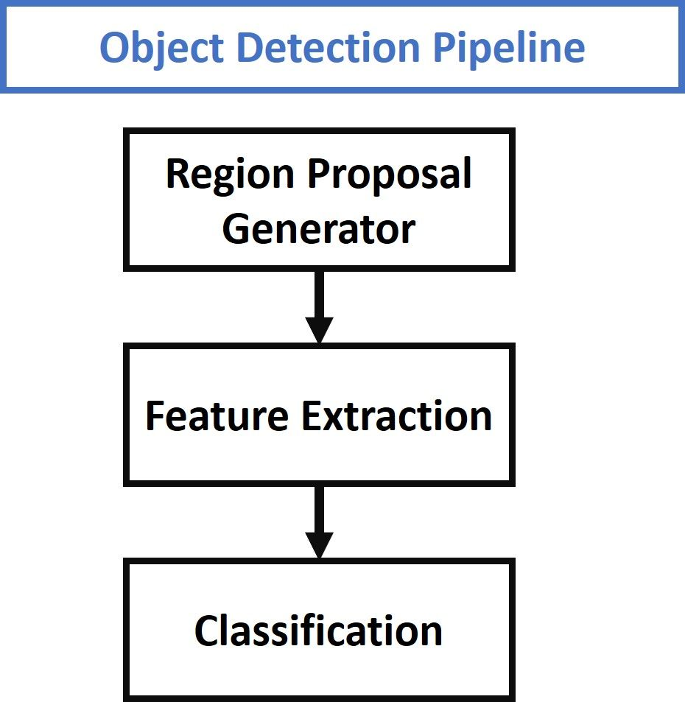
Object Detection Pipeline

Slide 5
Object Detection algorithms

Slide 6
Yolo Algorithm
YOLO is a fast and accurate algorithm that uses neural networks to provide object detection.
YOLO is an abbreviation for the term ‘You Only Look Once’. This is an algorithm that detects and recognizes various objects in a picture.

Slide 7
Yolo Algorithm
YOLO algorithm is important because of the following reasons:
Speed, : This algorithm improves the speed of detection because it can predict objects in real-time.
High Accuracy, as it provides accurate results with minimal background errors.
Learning capabilities, it is able to learn the representations of objects and apply them in object detection.

Slide 8
Yolo Algorithm
It works by dividing the image into N grids, each having an equal dimensional region.
These grids predict bounding box coordinates relative to their cell coordinates, along with the object label and probability.
This greatly lowers the computation as both detection and recognition are handled by cells from the image, but It brings forth a lot of duplicate predictions due to multiple cells predicting the same object with different bounding boxes.

Slide 9

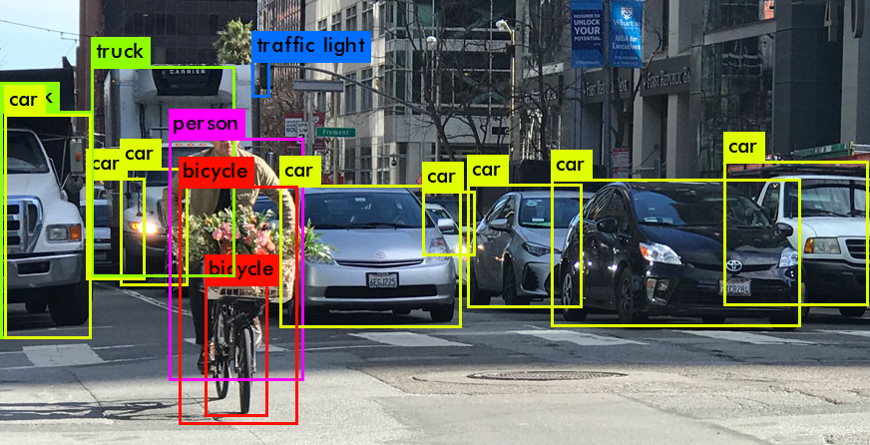




Slide 10
Yolo Algorithm
YOLO makes use of Non Maximal Suppression to deal with this issue.
It suppresses all bounding boxes that have lower probability scores.
It achieves this by first looking at the probability scores associated with each decision and taking the largest one.
This step is repeated till the final bounding boxes are obtained.

Slide 11
Yolo Algorithm
YOLO algorithm can be applied in the following fields:
Auto Driving
Security
Wildlife

Slide 12
Faster R-CNN Algorithm
We will start with R-CNN which stands for faster Region-based Convolutional Neural Network.
It is the first trial towards building an object detection model that extracts features using a pre-trained CNN.
Fast R-CNN is faster than the R-CNN but unfortunately neglects how the region proposals are generated.
And that has been solved later by Faster R-CNN, which builds a region-proposal network (RPN) that can generate region proposals that are fed to the detection model (Fast R-CNN) to inspect for objects.
Also, a popular model used for classifying the region proposals is the support vector machine (SVM).

Slide 13
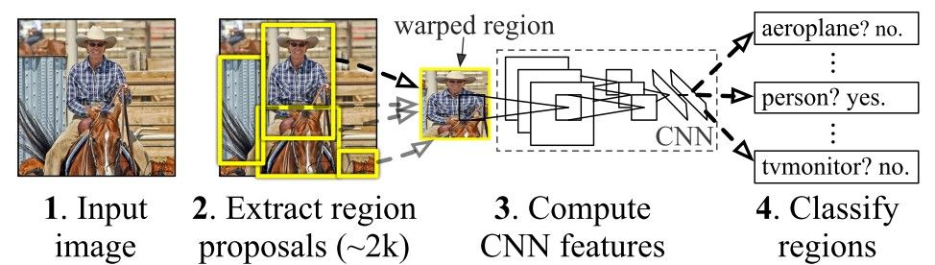
R-CNN Pipeline

Slide 14
Faster R-CNN Algorithm
Work Process of the R-CNN:
The input image is divided into ~2k region proposals via the selective search. Then resized to a fixed pre-defined size that goes into the CNN which extracts a feature vector of length 4,096 from each region proposal. A feature vector is fed to SVM that classifies the object.
Drawbacks of R-CNN:
each stage is an independent component. Thus, it cannot be trained end-to-end.
It caches the extracted features which requires hundreds of gigabytes of storage.
uses Selective Search algorithm for generating region proposals, which takes a lot of time.
each region proposal is fed independently to the CNN for feature extraction. This makes it impossible to run R-CNN in real-time.

Slide 15
Faster R-CNN Algorithm
Next is the Fast R-CNN:
Advantages of Fast R-CNN:
Fast R-CNN does not cache the extracted features and thus does not need so much disk storage compared to R-CNN.
Fast R-CNN shares computations (i.e. convolutional layer calculations) across all proposals (i.e. ROIs) rather than doing the calculations for each proposal independently through the new ROI Pooling layer to extract feature vectors, which makes Fast R-CNN faster than R-CNN.
single staged; It just accepts an image as an input and returns the class probabilities and bounding boxes of the detected objects.
Drawback of Fast R-CNN:
USES the time-consuming Selective Search algorithm which can’t be customized on a specific object detection task. Thus, it may not be accurate enough to detect all target objects in the dataset.

Slide 16
Faster R-CNN Algorithm
Finally, the Faster R-CNN which consists of 2 modules; RPN and Fast R-CNN
Work process of the Faster R-CNN:
region proposal network (RPN); that generates proposals with various scales and aspect ratios. It tells the object detection (Fast R-CNN) where to look for objects in the image.
fixed-length feature vector is extracted from each region proposal using the ROI Pooling layer.
The extracted feature vectors are then classified using the Fast R-CNN.
class scores of the detected objects and their bounding-boxes are returned.
Features of the Faster R-CNN:
computations are shared across the RPN and the Fast R-CNN in the Faster R-CNN which reduces the computational time.
region proposals are generated using a network that could be trained end-to-end and customized according to the detection task, thus it produces better region proposals.
the RPN and the Fast R-CNN can be merged into a single network so training is done only once.

